Slide 1


Slide 2
Welcome to Reception
Renoir class - Mrs Bowerman, Miss Castle and Madame Mills.
Monet class - Mrs Thana, Mrs Peters, Madame Fritz and Miss Buxton.

Slide 3
Daily routine
Soft start - children come and settle down with a book or quiet activity.
Register and our morning prayer.
Phonic / number carpet session.
Focused activity with small groups of children - with free flow activities.
Tidy up time.
Collective worship.
Focused activity with small groups of children - with free flow activities.
Tidy up time, wash hands, toilet and getting ready for lunch.
Lunchtime prayer.
Lunchtime.
Register and afternoon carpet session.
Focused activity with small groups of children - with free flow.
Tidy up time.
Story and milk time.
Getting ready to go home.
End of day prayer.
Home time.

Slide 4
7 Areas of Learning from Development Matters
The 3 prime areas are:
1. Personal, Social and Emotional Development
2. Physical Development
3. Communication and Language
As children grow, the prime areas will help them to develop skills in 4 specific areas. These are:
1. Mathematics
2. Literacy
3. Understanding the World
4. Expressive Arts and Design

Slide 5
Personal, Social and Emotional Development
Making relationships
Self confidence and self awareness
Managing feelings and behaviour

Slide 6
How are the children being independent?
What helps them play cooperatively?

Slide 7
PSED - How you can help?
Playing games which encourage sharing and turn taking will help your child to build their social skills
Being independent by making choices and trying new activities
Using language to express how they are thinking and feeling

Slide 8
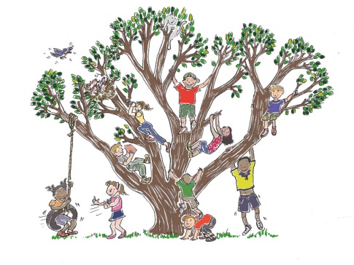
Physical Development
Moving & Handling
Health & Self Care

Slide 9
PD - How can you help?
Give children time to run, jump, climb and play outdoors
Encourage children in activities such as building, drawing, threading beads or filling and emptying containers in the water – all of which develop fine motor skills
Talk about how to be healthy

Slide 10
Communication and Language
Listening and attention
Understanding
Speaking
English as an Additional Language (EAL)
Supporting communication and language in EAL learners

Slide 11
CL- How can you help?
Listening and Attention
Encourage children to listen to others.
Listen to your child, talk about things they have done and answer their questions.
Use puzzles or games to help your child maintain attention and concentration for short periods of time
Understanding
Look at instructions to a game
Asking and answering questions
Speaking
Thinking about new words
Making up a role play story

Slide 12
Mathematics
Number
Shape, space, measure

Slide 13
Mathematics - How can you help?
Pointing out numbers all around
Singing counting songs and rhymes
Counting, adding and subtracting anything and everything - socks, cars, shopping, cutlery, fingers and toes!
Talking about the shapes you can see in the environment
Comparing things which are heavy and light or long and short

Slide 14
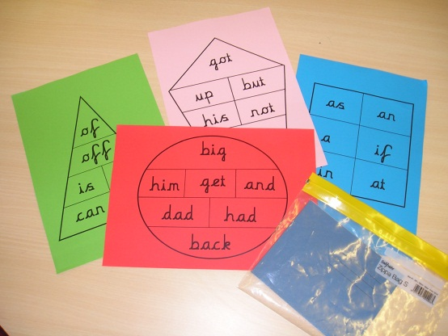
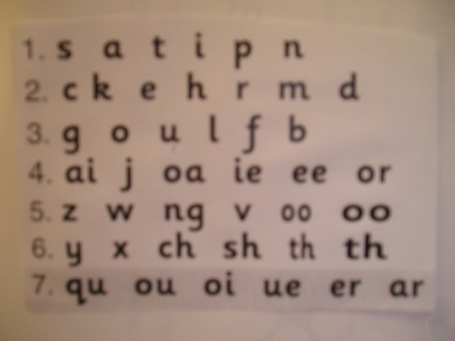
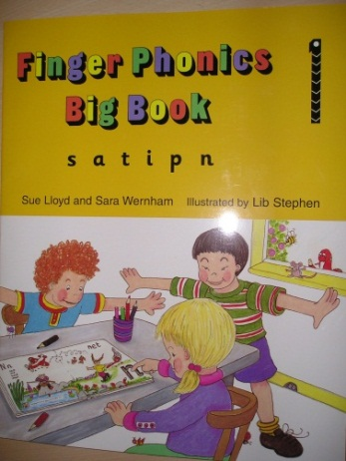
Literacy
Reading
Phonics and High Frequency Words
“Jolly Phonics” and “Letters and Sounds”

Slide 15
Writing

Slide 16
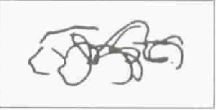
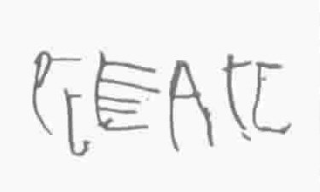
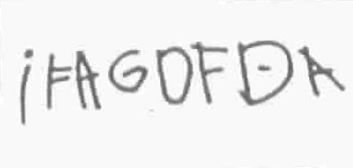
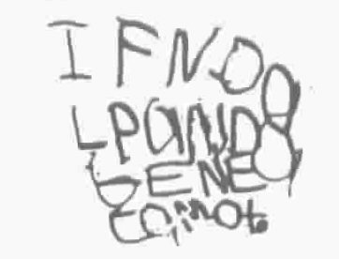
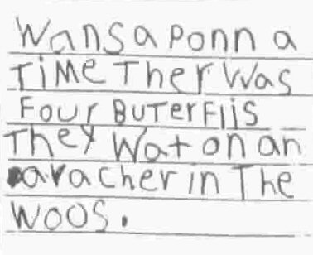
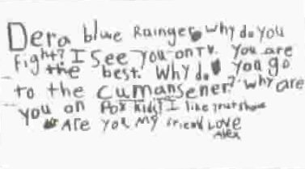
1) Emerging / scribbling
2) Pre-communicative
3) Semi-phonetic
4) Phonetic
5) Transitional
6) Conventional

Slide 17
Literacy - How can you help?
Reading books (stories, information books, newspapers, magazines, comics etc.)
Encouraging your child to talk about books – the story setting, the character, the plot, the humour etc.
Make writing fun – shopping lists, cards, letter to…
Encourage children to sound out words when writing
Handwriting - modelling correct letter formation and pencil grip

Slide 18
Understanding the World
People and Communities
The World
Technology
RE

Slide 19
Expressive Arts and Design
Being imaginative
Exploring and using media and materials

Slide 20

UW/EAD - How can you help?
Talk with your child about the places they go and things they see in the world around them. Help them to incorporate their knowledge into their imaginative play.
Answering and asking questions - What if…? Why do you think…? How did you…?
Letting children join in with everyday activities - washing up, cooking, shopping, helping in the garden etc.
Listen to music, thinking about the rhythms and patterns.
Help your children use ICT - CD players, mobile phones, iPads, computers etc.

Slide 21
En français !
Introduced for classroom routines
Lessons with “Camembear” in small group
Bilingual specific input based on the French programme of studies
Videos recorded of acquired songs and expressions
Be encouraging, congratulate and share with us!

Slide 22
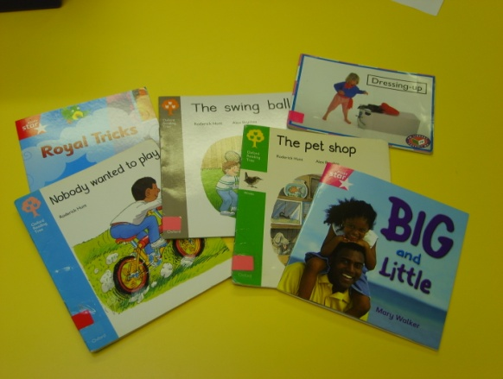
What will my child bring home?
Book Bag
Reading Book
Reading Diary
Key words
Letters
Active Learning
Other people’s clothes!

Slide 23
What we expect from parents:
To bring your child to school every day
To be on time for school
To ensure your child has correct, full school uniform
To label all items belonging to your child
To ensure your child brings in a water bottle
To bring in your child’s book bag every day
To read with your child every night (and sign the record book)
To order lunches in advance (and tell them what you have ordered for them)
To ensure your child has correct, full school PE kit
If you have any issues or concerns, please do come and speak to us.

Slide 24


