Slide 1
Open Coffee Morning

Slide 2
Highlights of PTFA Events

Slide 3
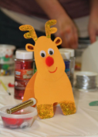
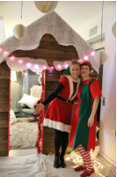
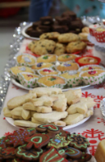
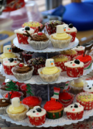
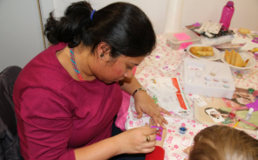
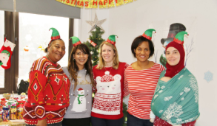
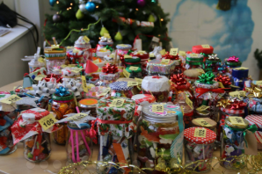
Christmas Bazaar - 9th December 2016
We Raised
£1,348.22

Slide 4
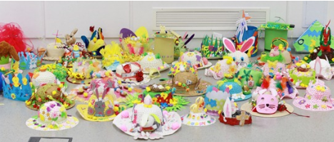
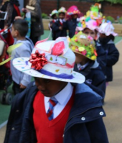
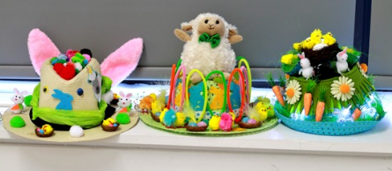
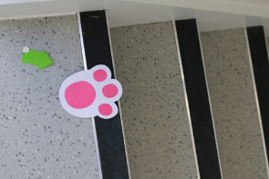
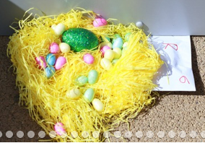
Easter Bonnet Parade & Easter Egg Hunt - March 2017
We Raised - £132.20

Slide 5
Cinema Night - 24th May 2017
We Raised - £237.70

Slide 6
Summer Fair - 15th July 2017
We Raised - £2602.54

Slide 7
Recipe Books – July 2017
We Raised - £76.25

Slide 8
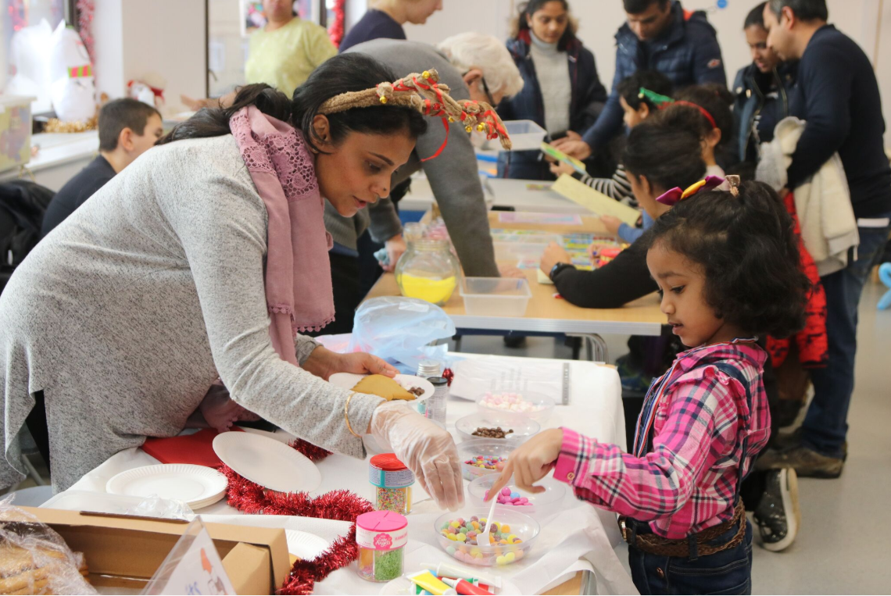
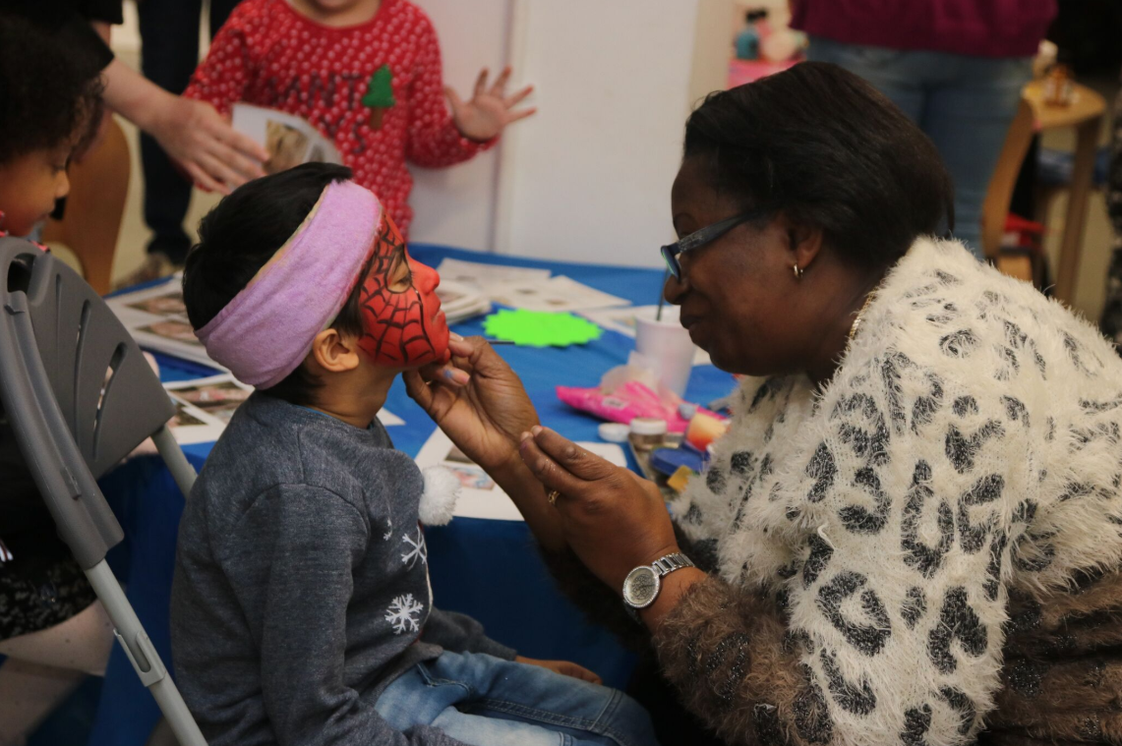
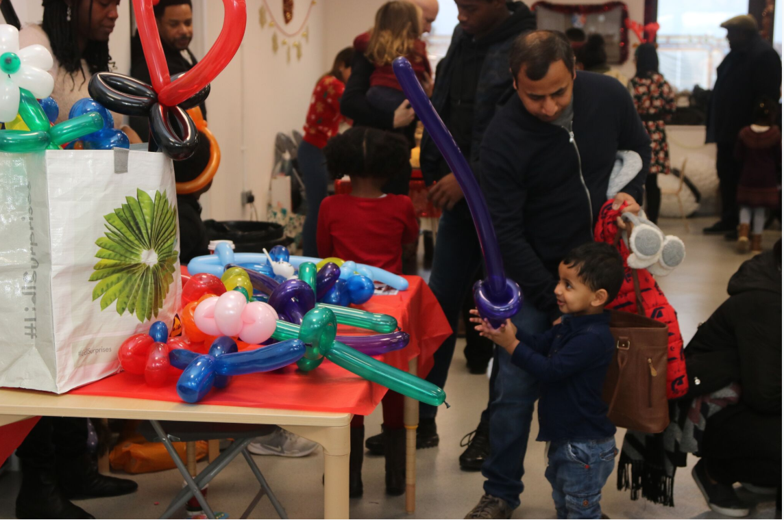
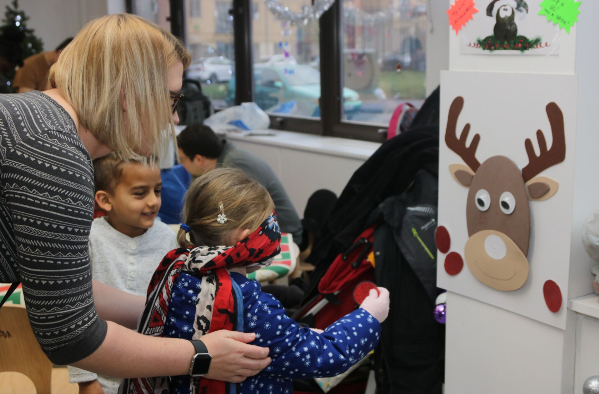
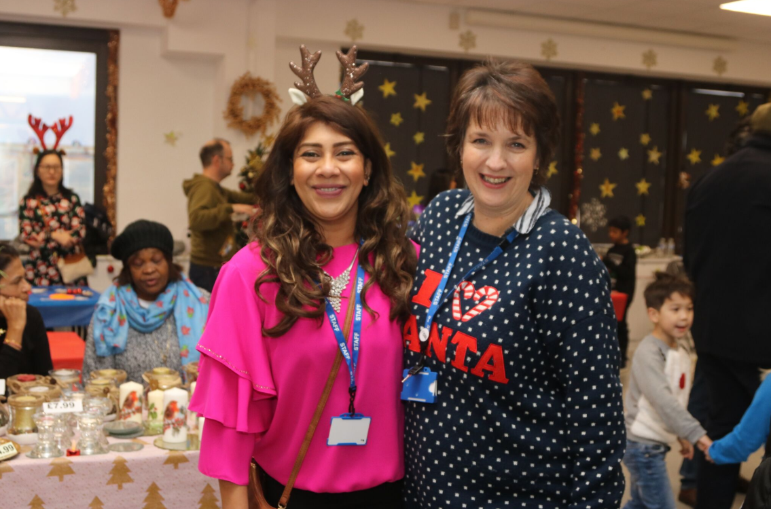
Christmas Bazaar – 16th Dec 2017
We Raised - £4168.69

Slide 9
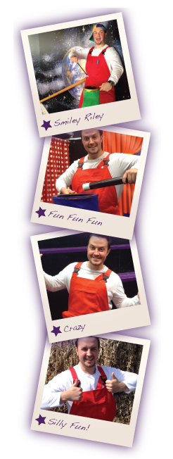
Glow in the dark Disco – 22nd Feb 2018
We Raised - £245.94

Slide 10
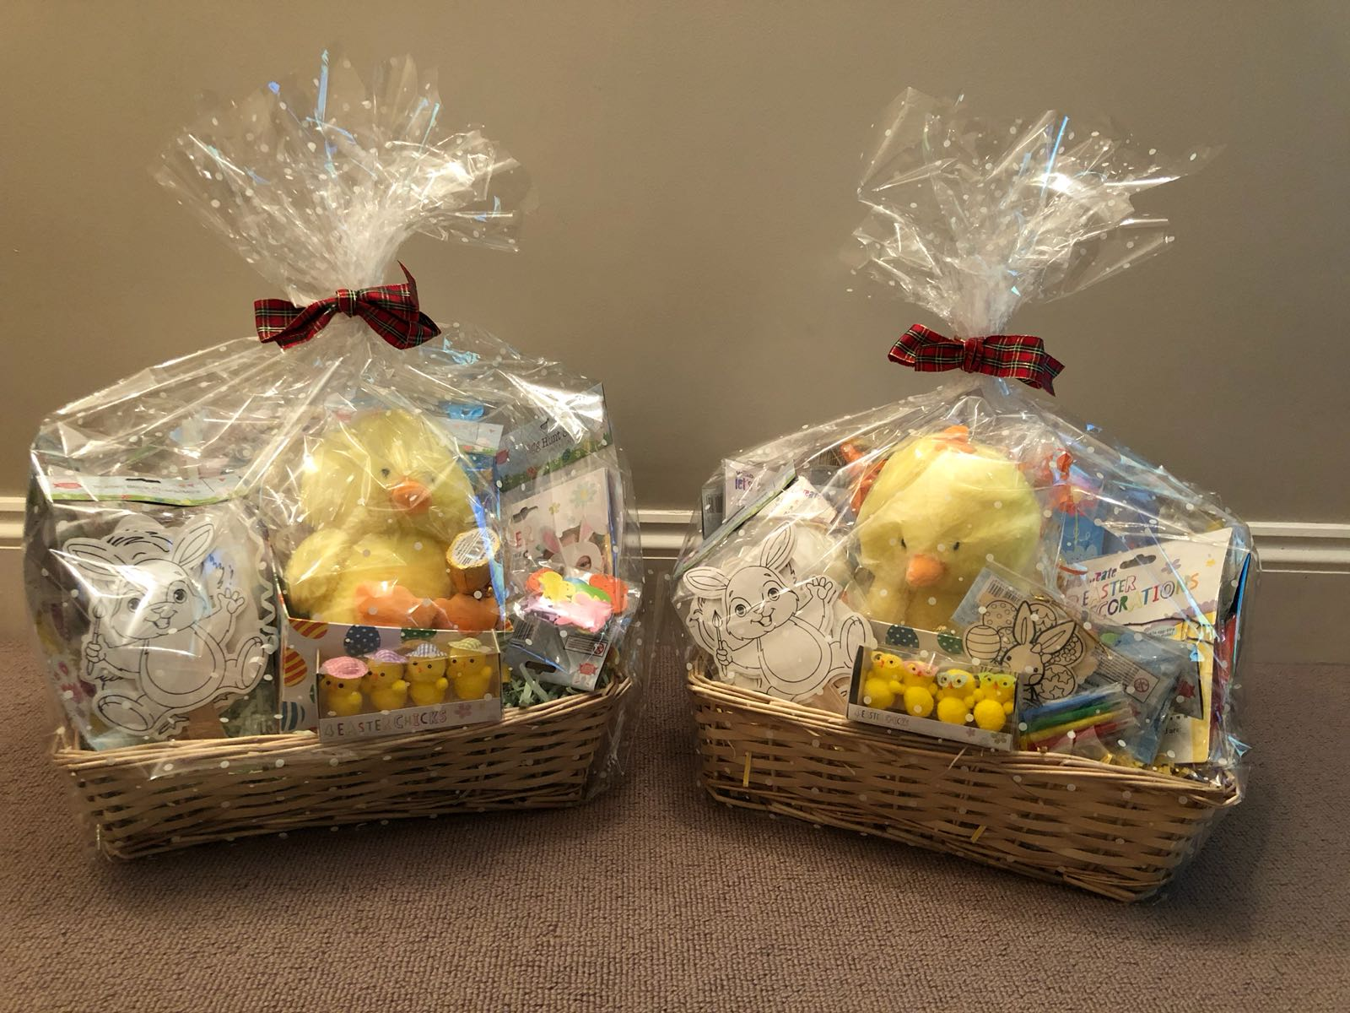
Easter raffle & Cake Sale 20th March 2018
We Raised - £231.34

Slide 11
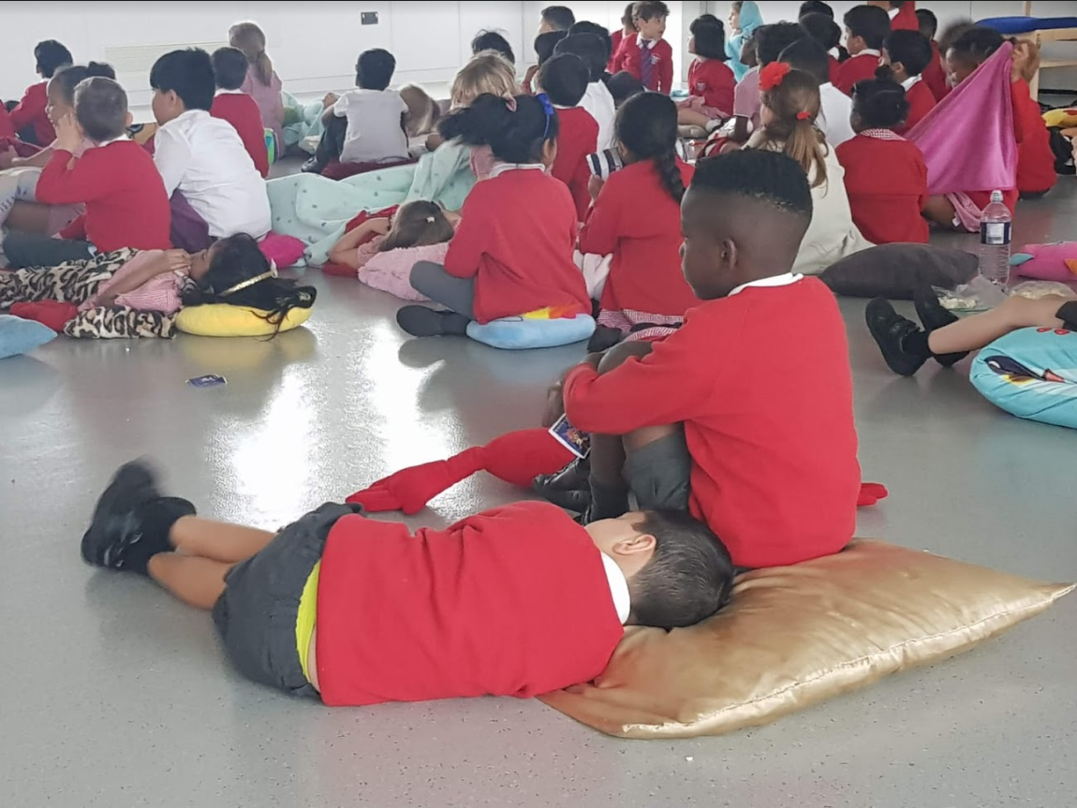
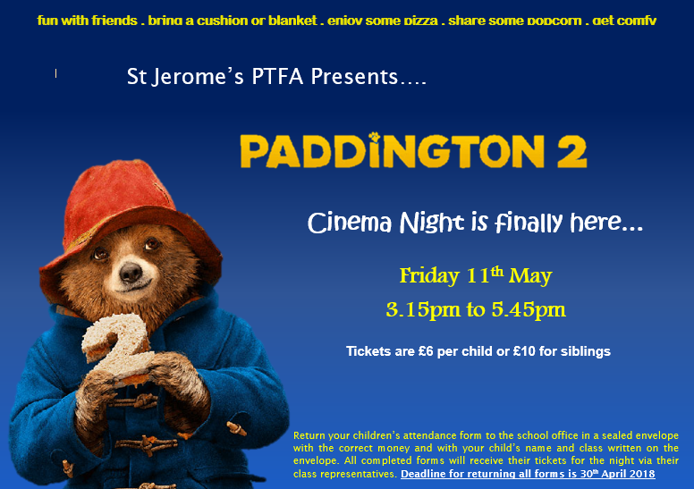
Cinema night – 11th May 2018
We Raised - £427.22

Slide 12
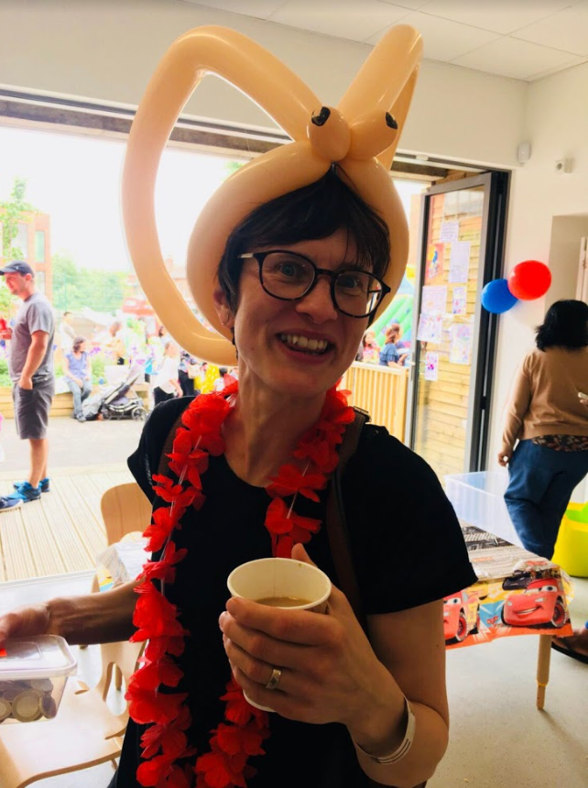
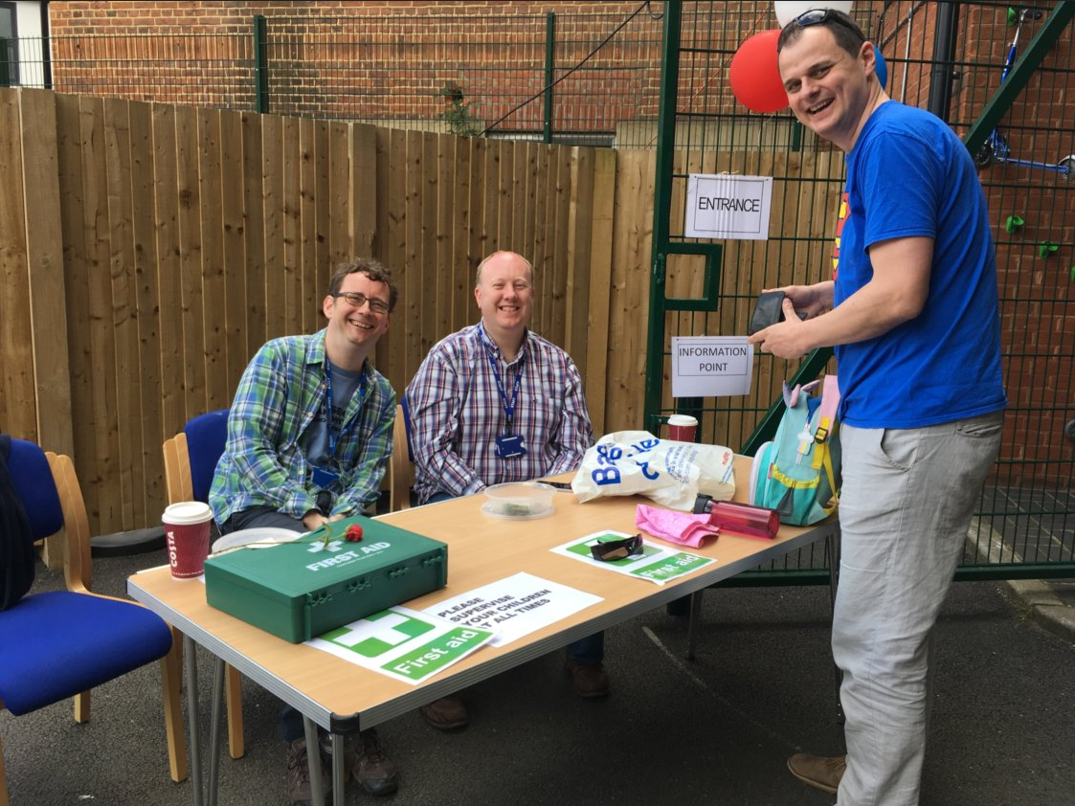
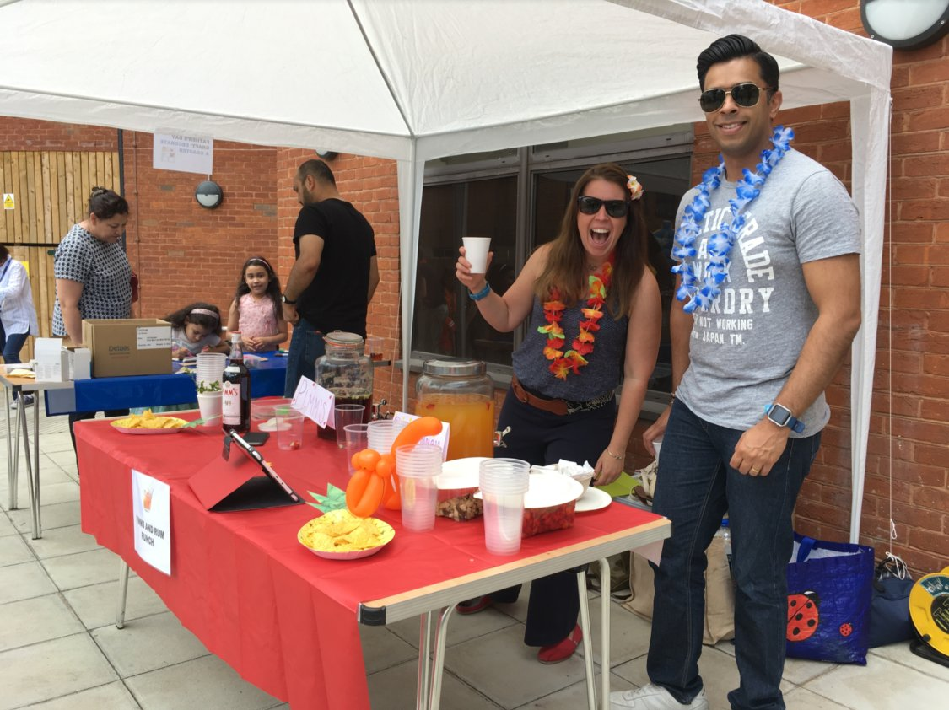
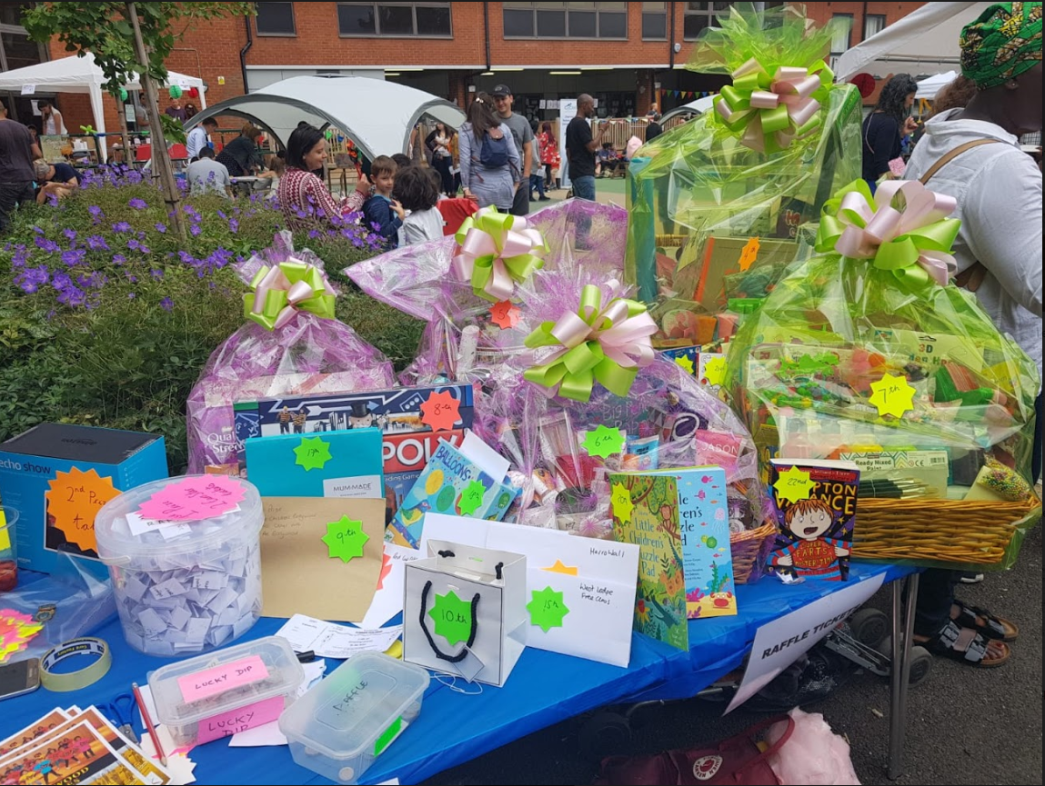
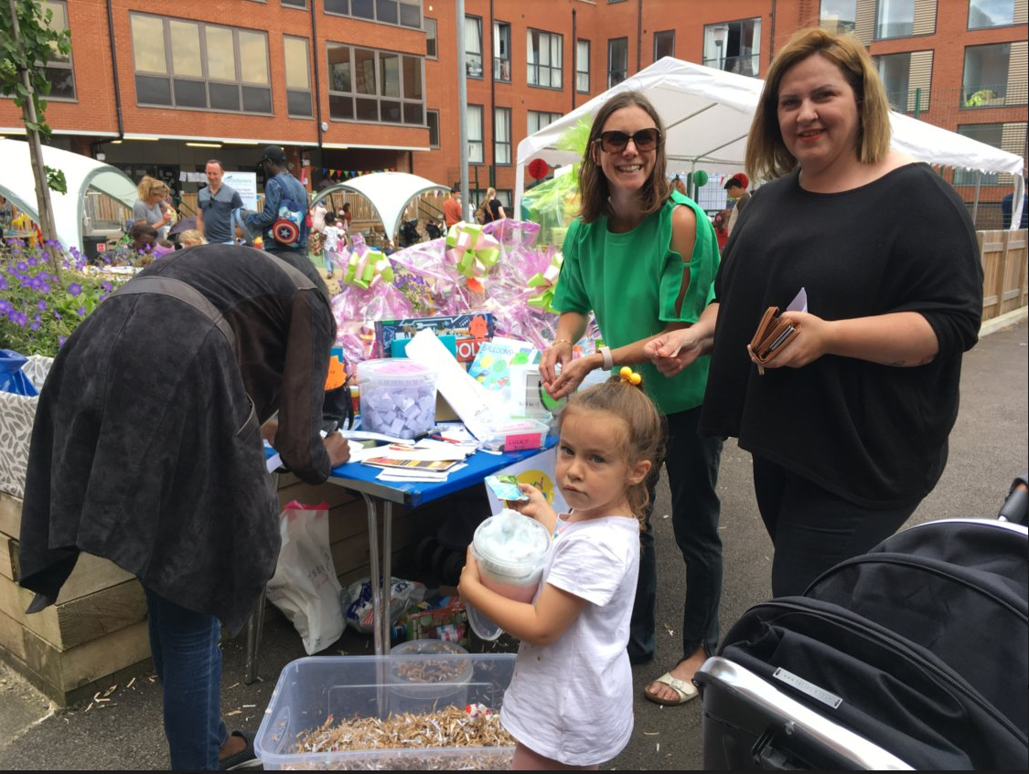
Summer Fair – 15th June 2018
We Raised - £1628.59

Slide 13
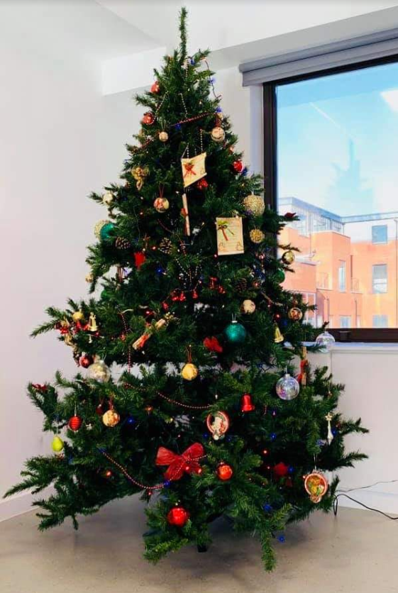
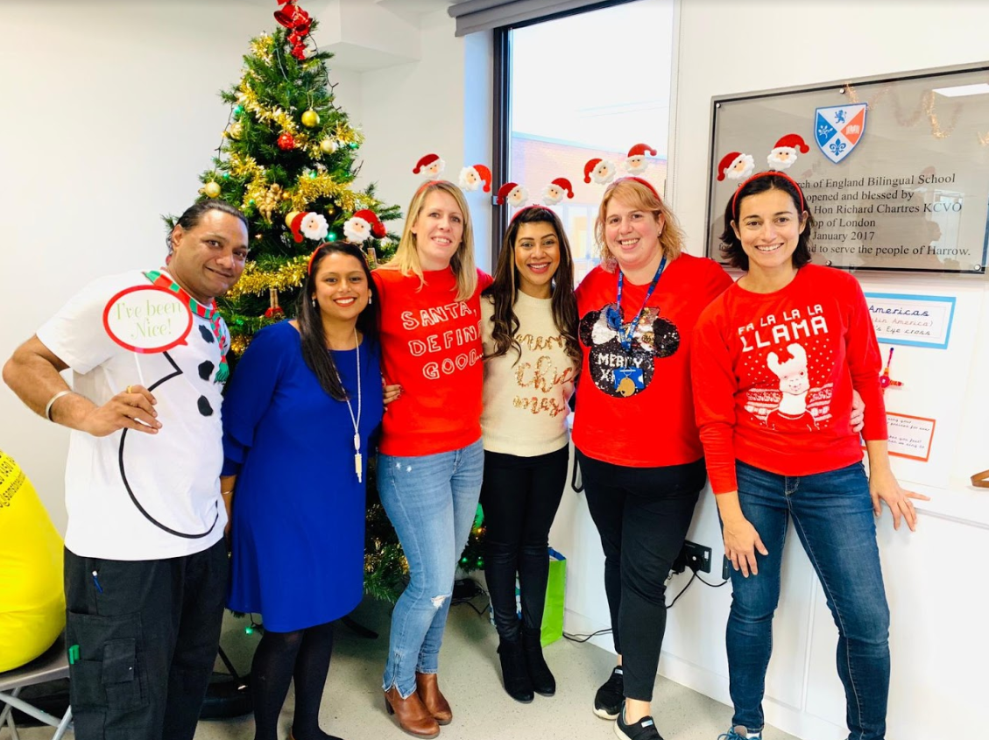
Christmas Bazaar – 17th November 2018
We Raised - £3686.13

Slide 14
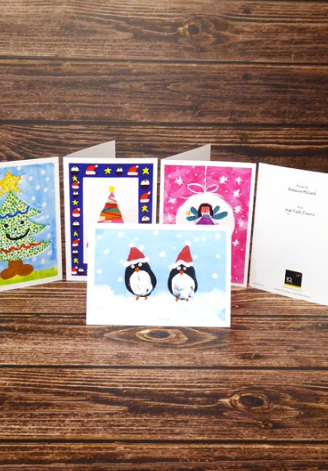
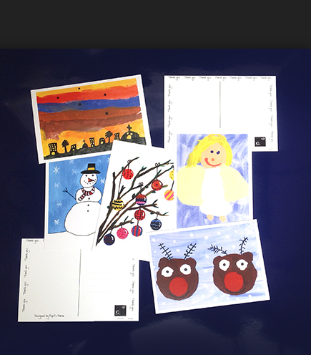
IQ Christmas Cards – December 2018
We Raised - £90.45

Slide 15
Donations from PTFA
£1578.94 towards School Library
£997.33 Featured Book Tree
Science Workshops - £648 for a full day of activities
Jack & the Beanstalk Pantomime - £539

Slide 16
What are you ideas?

