Slide 1
Colours of Easter The following images can be used in telling the story The Colours of Easter together. Simply show one picture at a time as you tell the story. The images are taken from the collection La Vie de Jesus Mafa, painted by artists in Cameroon. You can find the images to download from the Digital Library of Vanderbilt University, Nashville, Tennessee in the USA. http://diglib.library.vanderbilt.edu/ JESUS MAFA is a response to the New Testament readings from the Lectionary by a Christian community in Cameroon, Africa. Each of the readings were selected and adapted to dramatic interpretation by the community members. Photographs of their interpretations were made, and these were then transcribed to paintings. Based on Godly Play principles and stories, this has been written by Kathryn Lord, on behalf of Godly Play UK, especially for this time, at Easter 2020, when we cannot meet. Use what you can and share generously! www.godlyplay.uk www.godlyplayfoundation.org www.godlyplayscotland.co.uk

Slide 2
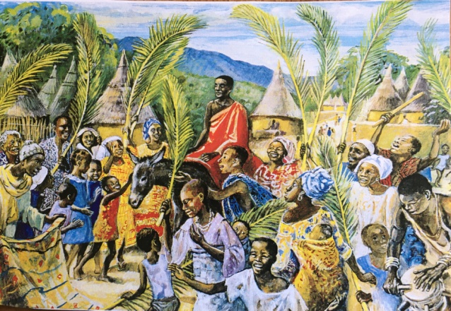

Slide 3
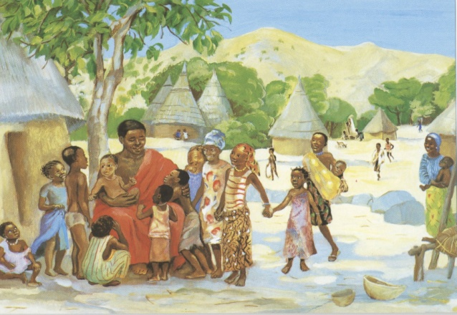

Slide 4
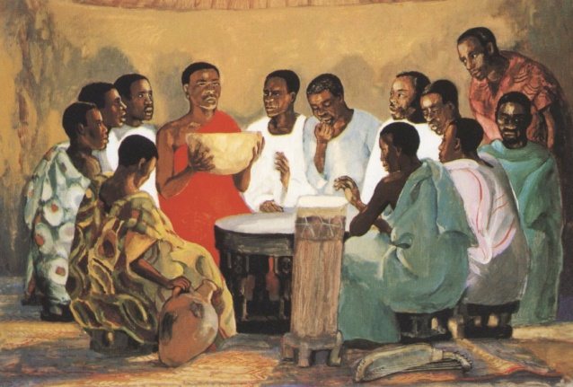

Slide 5
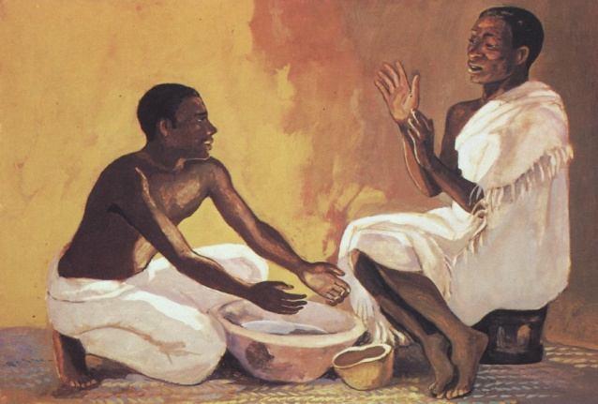

Slide 6
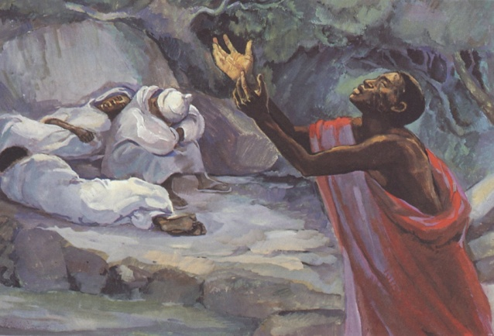

Slide 7
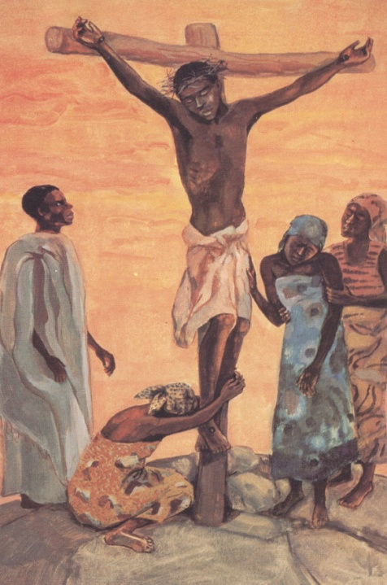

Slide 8
